Slide 1
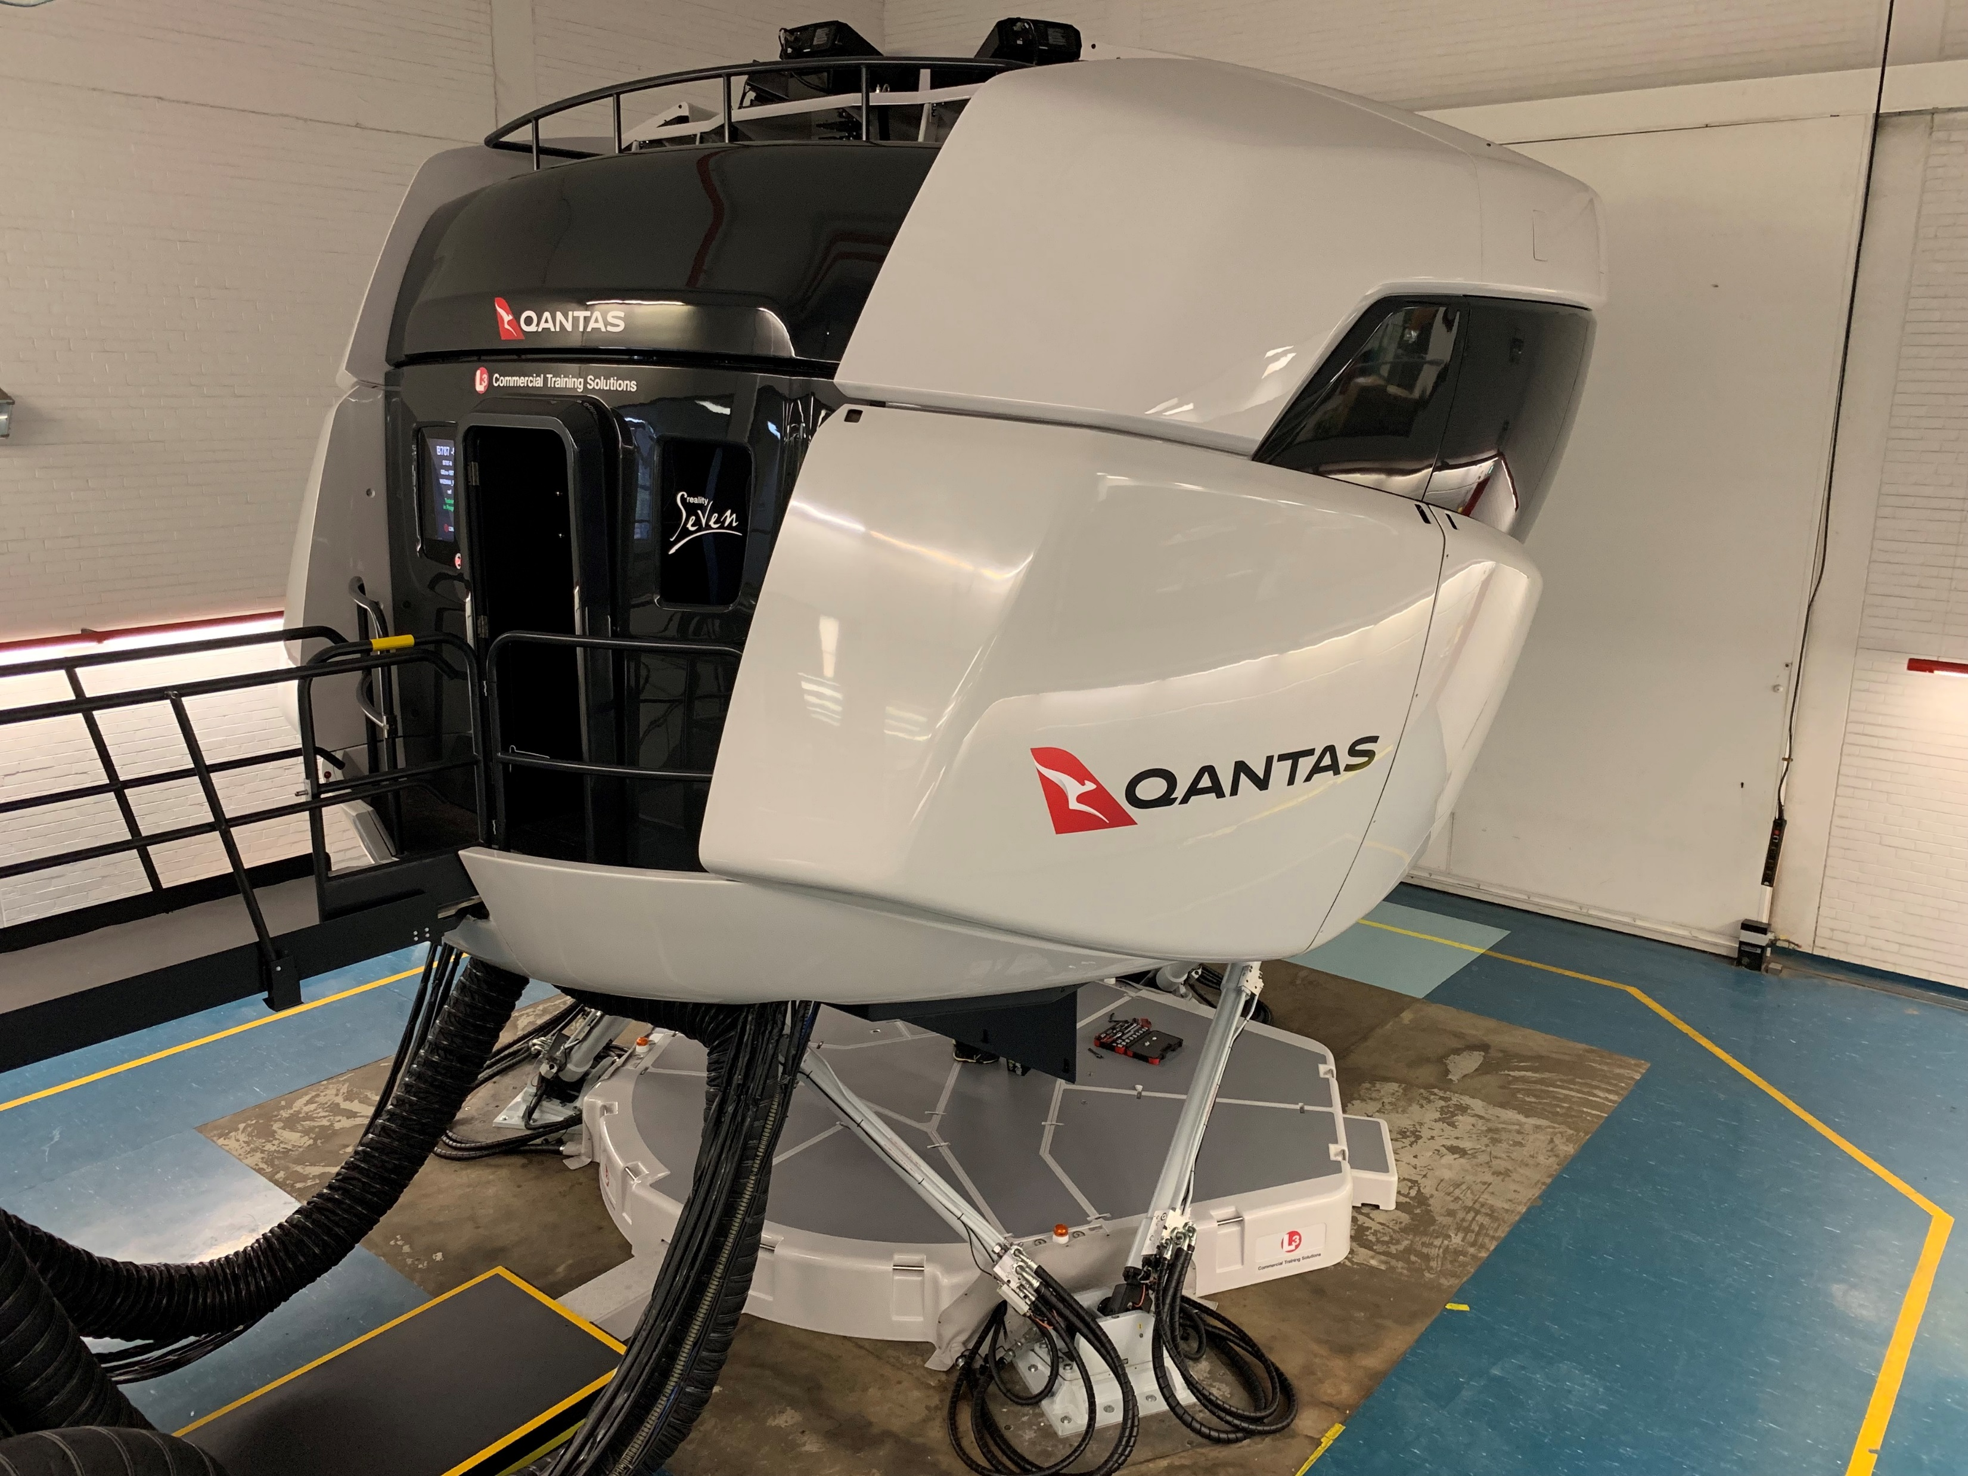
L3 787 Simulator INSTRUCTOR QUICK START GUIDE
QANTAS FLIGHT TRAINING

Slide 2
Part 1
OVERVIEW
The objective of this guide is to provide basic information to instructors on the use of the L3 Harris 787 Simulator in Sydney.
For amendments / additions to this guide please email peterjansen@qantas.com.au
The following comprehensive guides and training aids are also available and should be referenced as required;
Simulator Safety Brief
Briefing Station Quick Start Guide
Debriefing Station Quick Start Guide
Instructor Reference Manual
Software IOS Program

Slide 3
GENERAL INFORMATION
The Simulator is manufactured by L3 Harris. The IOS is similar to Qantas Simulators from Thales and the Boeing Simulators used in Singapore and Shanghai.
The Simulator is Sim 77
The Simulator is registered VH-SNH, it has 76K engines. ZNH should be used for OPT calculations
Common performance figures for 787-9 across the CAE and L3 simulators are used for Machwave lesson plans. Thrust on L3 will be slightly higher and conservative
The Simulator is located in the bay previously occupied by 747 Sim 5
A briefing room with Flight Deck panel display, whiteboard, TV with AppleTV and a briefing station PC is available
A debriefing room with whiteboard, Flight Deck panel display, debriefing station PC and CMS PC is available
Advise crew to take care not to scratch windows when using IPAD pivot mounts

Slide 4
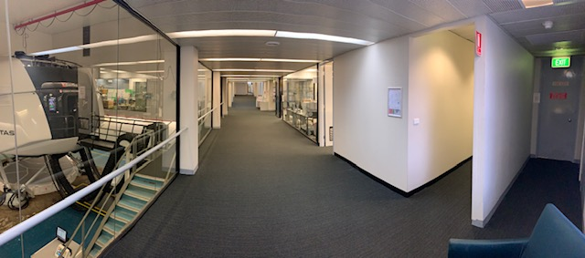
LOCATION
Level 1 Qantas Flight Training Center
Turn right out of the elevator then first left
TEA ROOM
DEBRIEFING
BRIEFING
BUILDING
EXIT

Slide 5
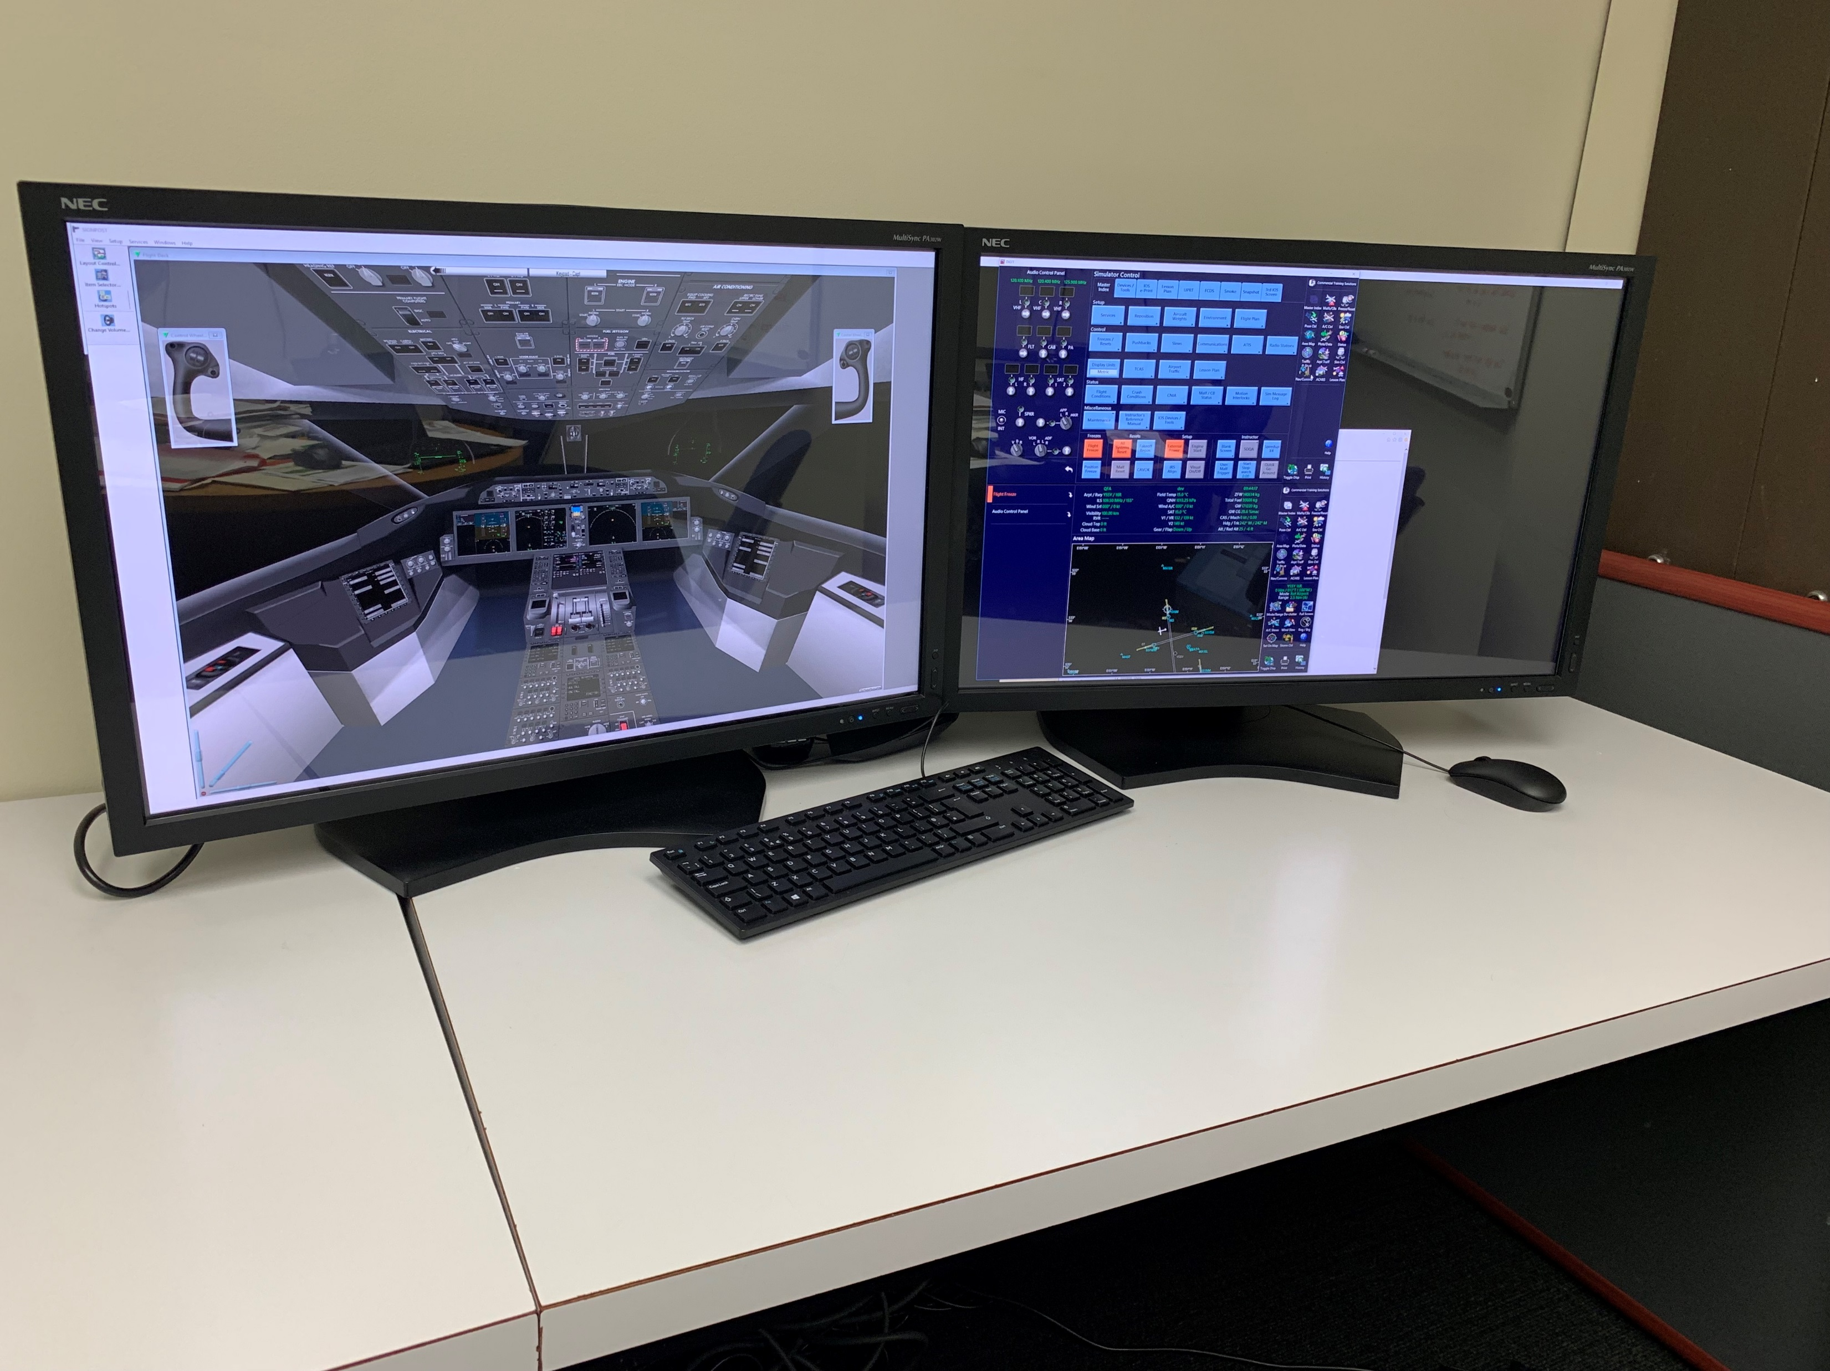
BRIEFING ROOM
The Briefing Room has a Briefing Station.
The briefing station is a PC based Flight and IOS Simulator (no visuals)
Refer to separate Quick Start Guide for operation (A full Instruction Manual can be accessed by pressing F1 on keyboard)

Slide 6
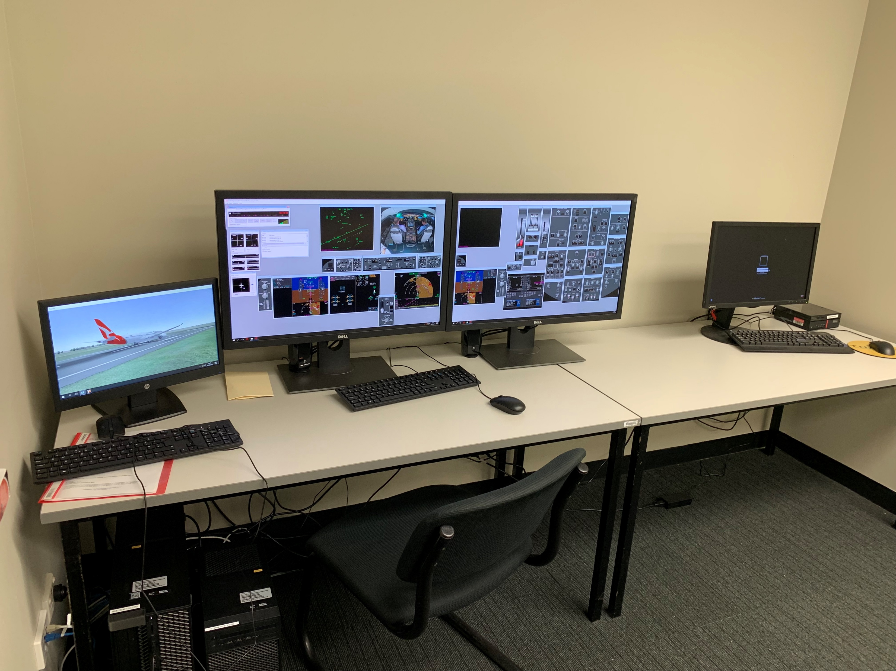
DEBRIEFING ROOM
Debriefing Station
Refer to separate Debriefing Station Quick Start Guide

Slide 7
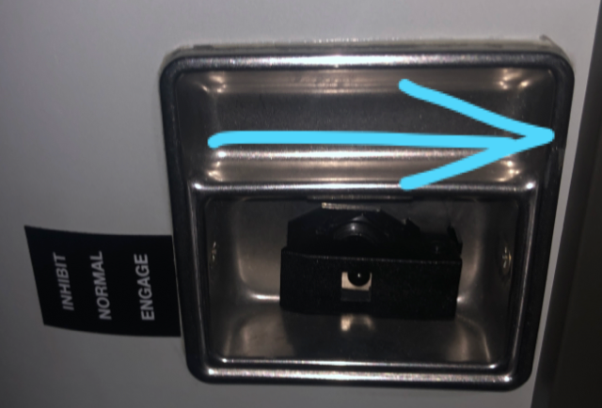
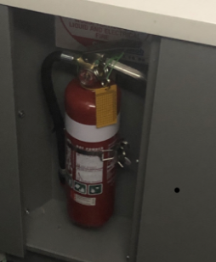
SIM SAFETY
Refer to full Sim safety Brief
Loose items secure
Motion on – Harness on
Flight Freeze active and sufficient lighting for seat changes
Emergency Stop – Cuts all power (Extensive maintenance action required)
Emergency Motion Off – Cuts power to motion only
Control cut-off (also cuts motion) – In ash tray next to each pilot
Fire Extinguiser – Rear of Sim used to evacuate the building

Slide 8
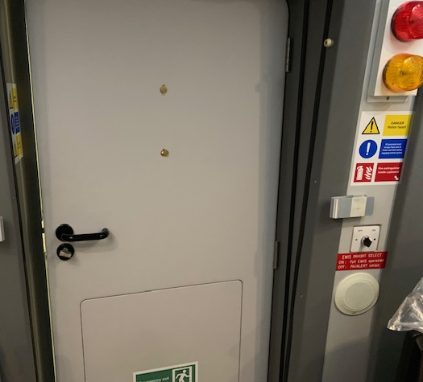
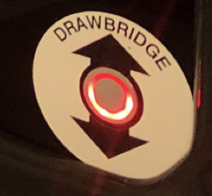
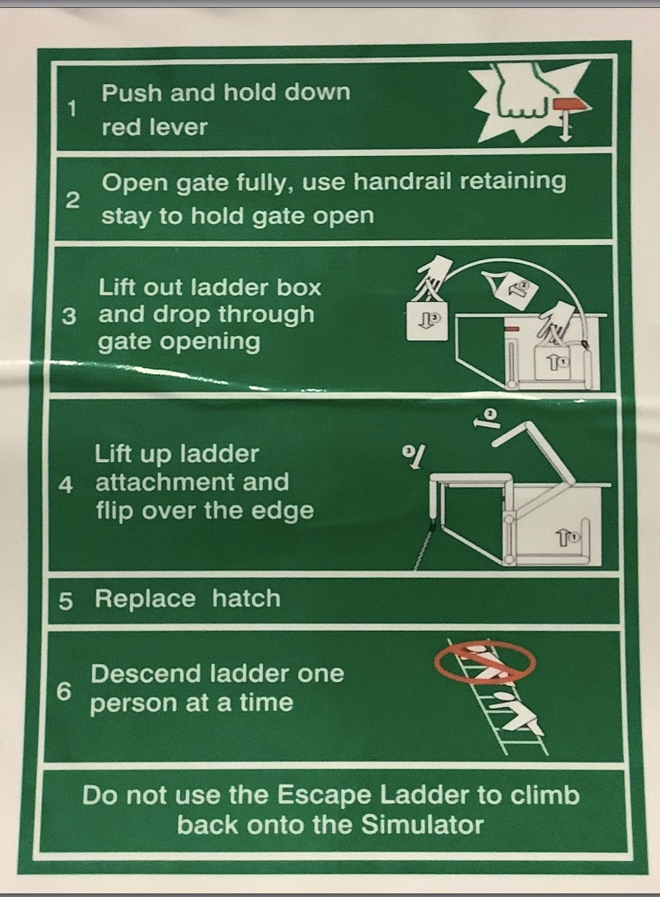
SIM SAFETY
Refer to full Sim safety Brief
Evac warning Red Light
Alert Yellow Light
EWIS (Emergency Warning and Intercommunication System) Inhibit switch - Normal position is ON (Full EWIS operation)
Kick panel in door
Drawbridge button if bridge remains up
Ladder if drawbridge will not lower
Building Exit – NE and S corner. Glass Doors or Red Door

Slide 9
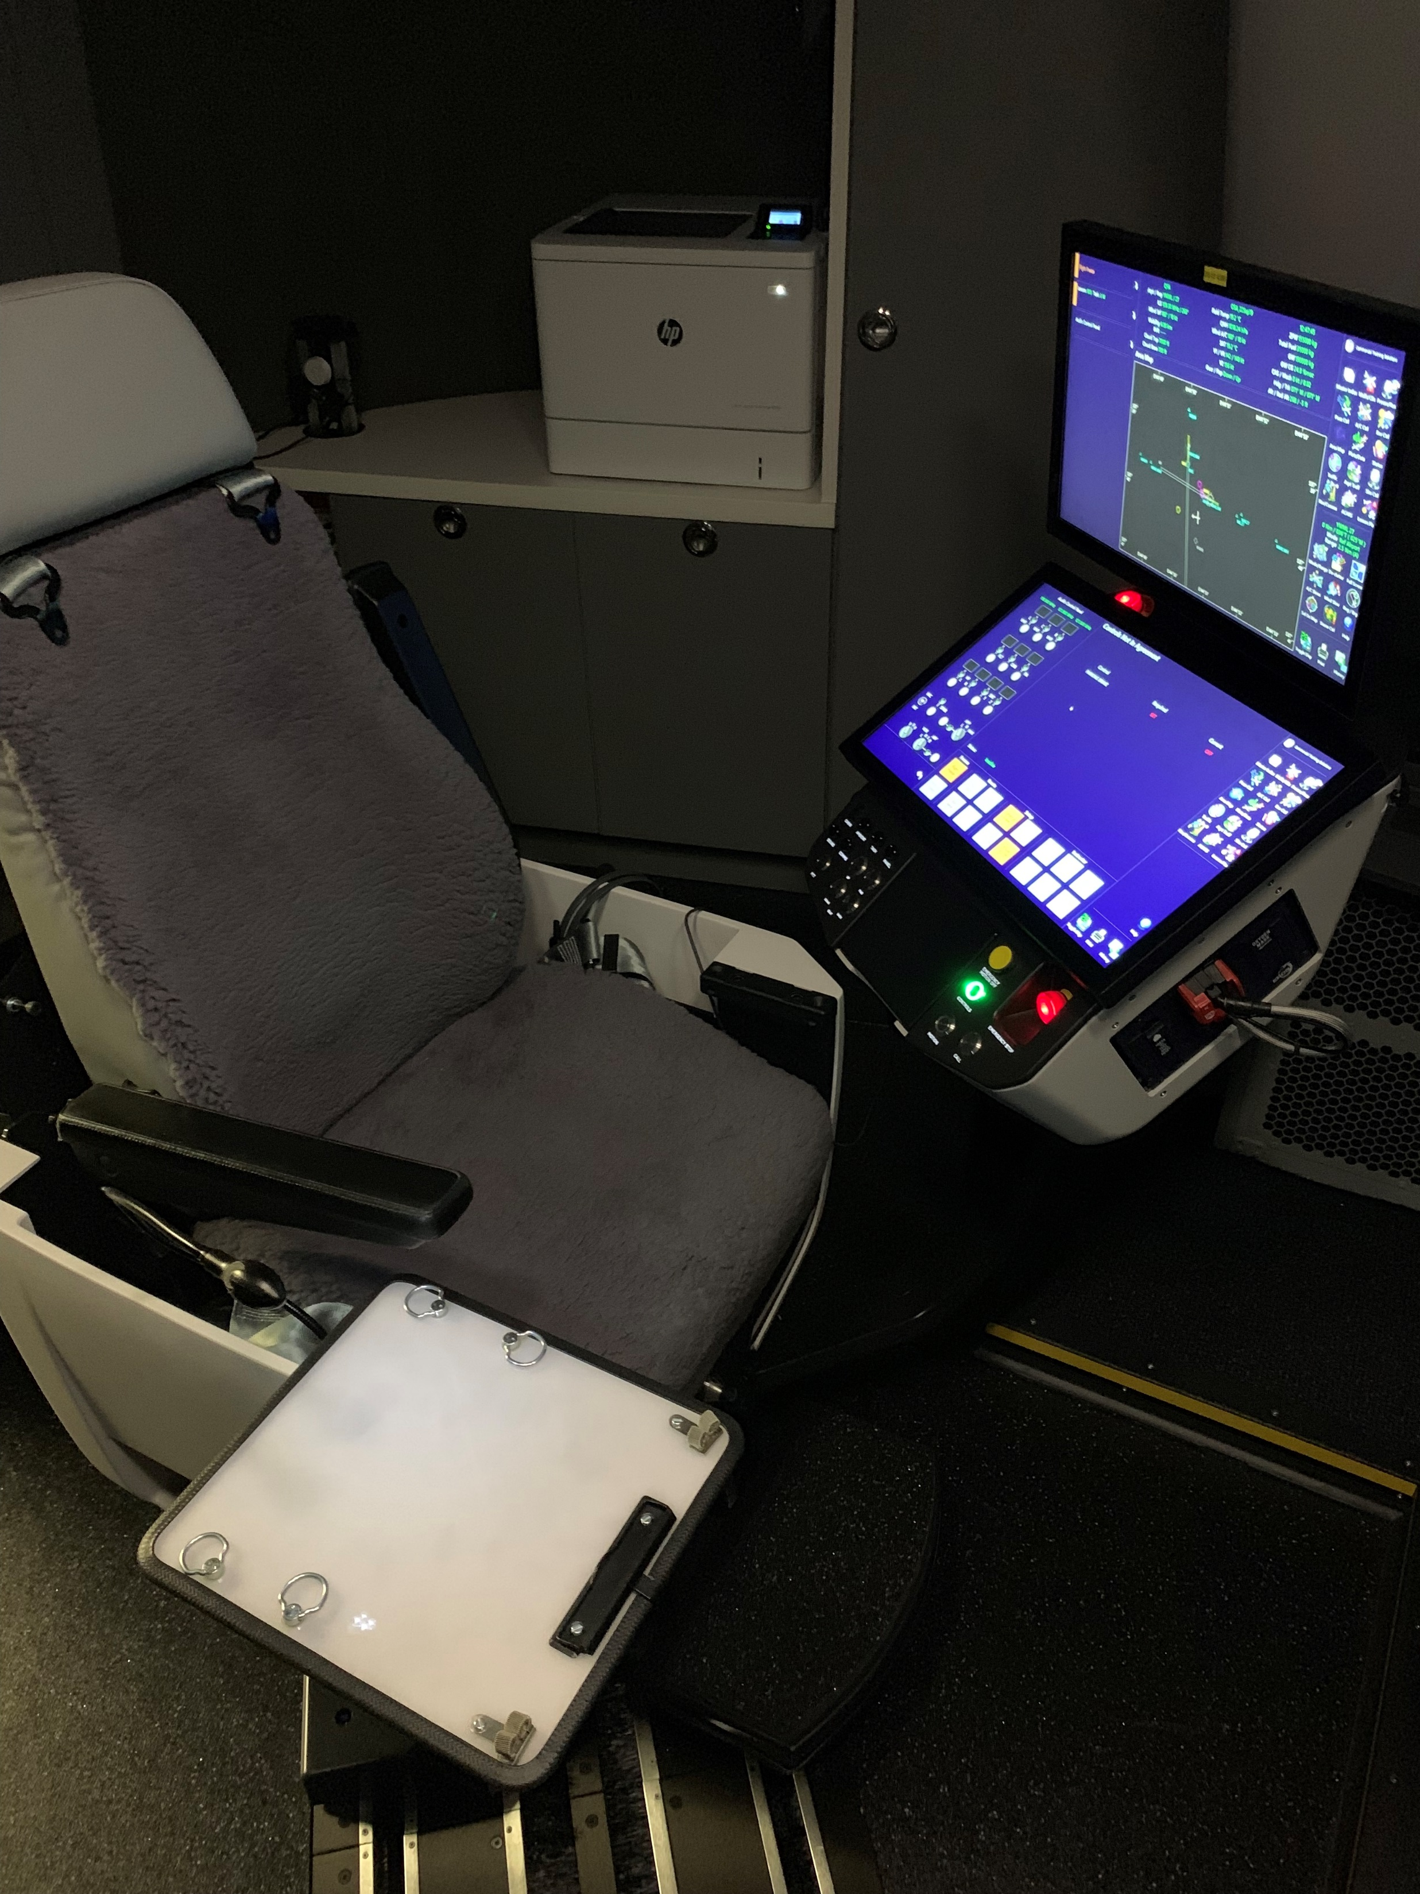
INSTRUCTOR STATION
Printer – Can print plots from IOS for Debrief
Top IOS screen can twist to show crew
Remote IOS storage when not in use
SANI WIPE Storage
EMERGENCY STOP
O2 (filtered air) mask for instructor if using smoke
IPAD/Remote IOS storage during training

Slide 10
INSTRUCTOR STATION
EMERGENCY SHUTDOWN
Lighting Controls
Motion and Control Loading
Seat Controls
* Motion can take up to 3min to activate *
Not Used
Simulator Master Volume and Comms Volume

Slide 11
START UP
If required to repower the Aircraft after a sim reload or complete power down the following procedure MUST be followed for simulator stability.
Select BATTERY ”ON”
WAIT 50 SECONDS for left CCR to power up identified by the CAPT PFD and ND powering up.
Select FWD EXT PWR “L” and “R” ON or power up the APU.
WAIT 3 MINUTES for the Master Warning light to illuminate and the stick shaker to activate.
Not waiting can cause various erroneous messages to appear.
Select LEFT and RIGHT IRS to “ON” and select “IRS Align” on the IOS for an instant align.
Select L and R Fuel Control Levers to “RUN” and select “Engine Start” on the IOS for instant engine start if required.
Ensure there a no unexpected ADVISORY or STATUS messages.
If there are you can try the following to clear the messages depending on the fault:
All Systems Reset.
Master Reset.
L & R CCR overhead reset and wait 3 minutes for the stick shaker to activate.

Slide 12
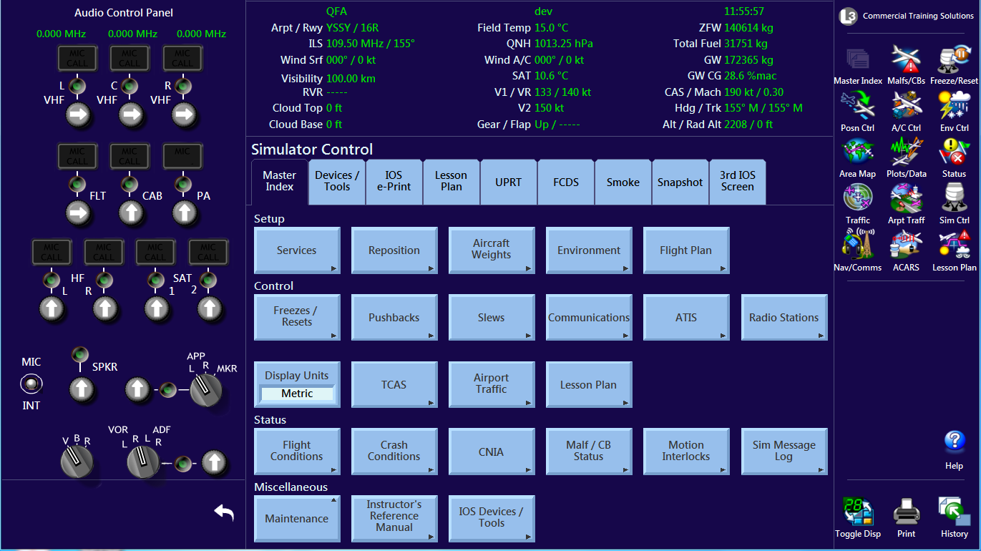
IOS
A full Instructor Reference Manual is available through the IOS using the “Help Icon”. Access to this guide is also provided in the Instructor Training material.
A software simulated IOS is available in the Instructor Training material

Slide 13
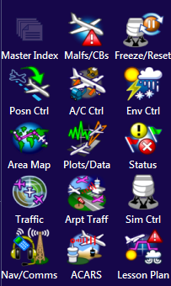
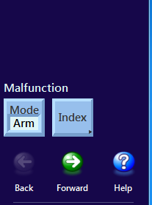
IOS HINTS
Use the Toolbar Icons on the right of the screen to select the desired tab suite.
Select the desired page from the tab suite
A tab may have multiple pages or a scrollable page. A page navigation menu will display navigation options under the Toolbar.
If visuals “Time Out” turn back on using “Secondary Display” on IOS. Use Toggle Display Icon to show Secondary Display.

Slide 14
Part 1
KNOWN ISSUES
REFER TO TECHLOG FOR UP TO DATE INFORMATION
Flight Controls – A grainy feel/effect is evident through the Capt’s & FO’s column/wheel during the flight control checks. This is a system limitation and is not felt during normal flight. It has been assessed as acceptable.
Visual Focus / clarity – some sign boards approach lighting etc can appear out of focus. These are still within required limits however improvements are ongoing.
If motion or controls trip off the simulator will come off motion however the bridge must be manually lowered. This is by design. Ensure simulator has lowered to correct position before using the manual bridge button near simulator entry door. If any doubt exists contact maintenance.
Capt ALTN ATT – It has been observed at times when selecting the Capt’s AIR DATA/ATT switch to ALTN the Capts attitude display blanks. This has training ramifications during an Airspeed Unreliable event. It is suggested to check the function of this switch prior to conducting an Airspeed Unreliable Event. This can be rectified by powering down the aircraft as per FCOM procedure and then powering up as per START UP procedure in this guide. Or a sim reload by maintenance staff

Slide 15
Part 1
KNOWN ISSUES
REFER TO TECHLOG FOR UP TO DATE INFORMATION
Hot Mic – A hot mic function as fitted to the CAE Simulator is not currently available
FMC staying in Air Mode on ground – It has been observed that Thrust Ref is GA and unable to enter takeoff thrust and speeds on the ground. FIX - Park the brake, remove Flight Freeze, select Idle reverse, de select idle reverse. FMC should change to On Ground Logic. (This also occurs and the fix works on the CAE simulator)
Snap Shot Function – This function is currently not working. Do not use
After a sim reload check database – Check correct Nav Database (date), Checklist Database (QF load) and Moving Map database (date) after a sim reload.
C VHF Data – After a sim re load Data not selected on center VHF. Go to COMM>MANAGER>VHF> DEFAULT RADIO MODE DATA > ON
Inflight weight changes will cause an Airspeed Unreliable – System Reset before removing Flight Freeze
System Reset in air cause Flight Freeze – this is by design to ensure a flight control reset does not cause a pitch change.

Slide 16
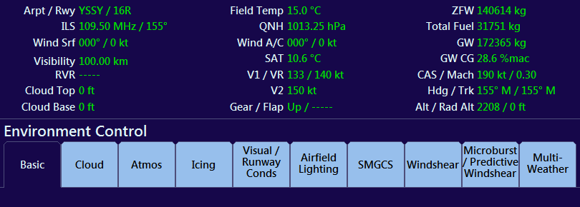
Part 1
WEATHER AND WEIGHTS
Weather is set using the Environment Control tab suite
Weights are set using the Aircraft Control tab suite
When adjusting weather conditions and weights the new conditions take time to adjust. The status of the change can be watched in the status table.

Slide 17
Part 1
WX, WEIGHTS HINTS AND TRICKS
Changing the weight of the aircraft in flight will result in an Airspeed Unreliable unless a System Reset is performed
Changing cabin occupancy will adjust weights do this before other weight adjustments
Windshear
A number of windshear profiles are available – click on the Help Icon to view the effects of each profile
The profiles are set as a percentage
The profile intensities approximate the CAE settings as follows
Light – 25%
Moderate – 55%
Severe – 80%
Non-recoverable – 100%
55% has been assessed as a good training point
For WTA VR-8 at heavy weights a Windshear warning will not be issued as the acceleration rate is such that the aircraft will take off with a steady wind – strong tail wind and not sense a Windshear. 30% will produce a warning.

Slide 18
Part 1
WX, WEIGHTS HINTS AND TRICKS
Microburst/Predictive Windshear
Check Intensity as at time of writing some default values are incorrect
Ensure Predicitive Windshear Detection System enabled
When windshear removed storm must be manually removed

Slide 19
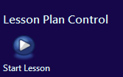
Part 1
AUTOLESSON PLANS
Most current sessions have an Auto Lesson Plan loaded
As a minimum they have the starting WX, weights and reposition
LOS/LOFT scenarios have more detailed Auto Lesson Plans
For changes to lesson plans or to report problems peterjansen@qantas.com.au
If all lessons are missing please make a tech log entry
To start an Auto Lesson Plan click on the Lesson Plan Icon in the Task Bar
Click on the desired Lesson and Click On View
If view is “grayed out” click on Refresh Table
When the lesson is displayed click on Start Lesson
Lessons progress from Left to Right

Slide 20
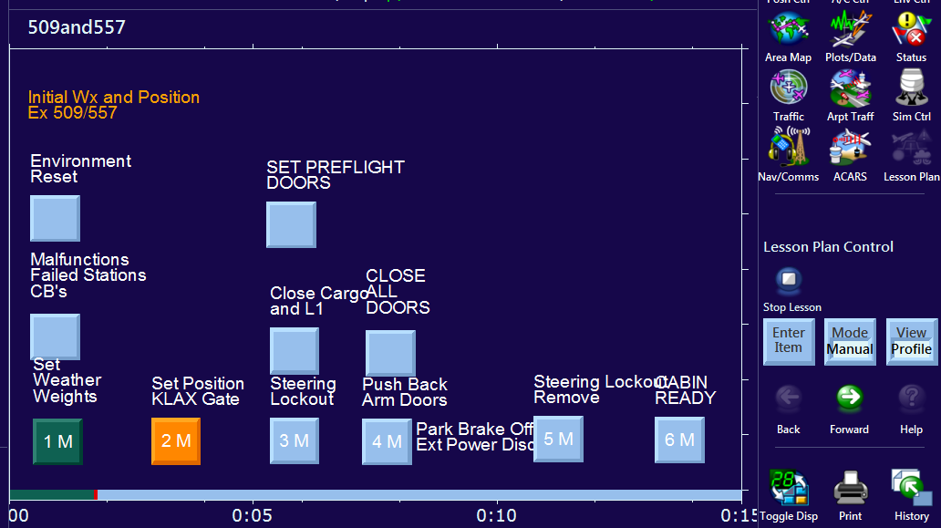
Part 1
AUTO LESSON PLANS
Armed Sequenced Item
Activates when Enter Item Selected
Non Sequenced Item
Activates as soon as pressed
A sequenced item can be armed or activated out of sequence by pressing on it. Wait for an Item to change from Red to Green before proceeding

Slide 21
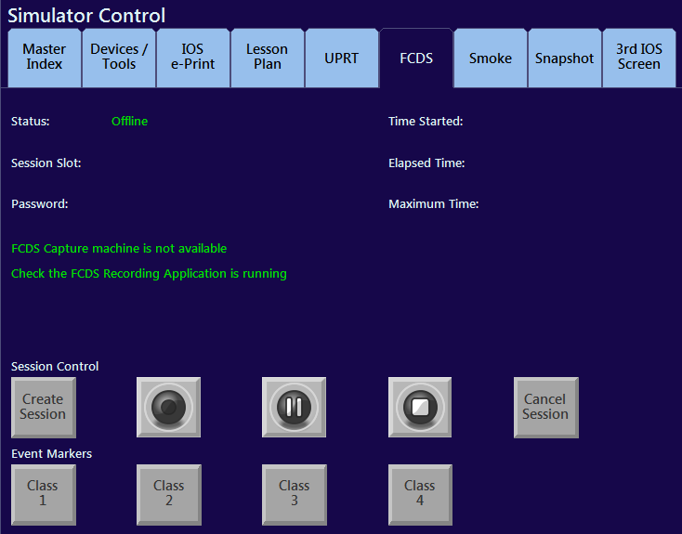
Part 1
FCDS-Flight Crew Debrief Station
Refer to Debriefing station quick start guide for more information
Recording must be started on the IOS
Select the FCDS tab on the Master Index Tab Reference suite
Difficulties may be experienced loading long recording (fix is being explored) it is recommended to end a recording at the start of the break and start a new recording for the second half of session. (Up to 5 recording can exist at a time)
Recording can be played back in debriefing room

Slide 22
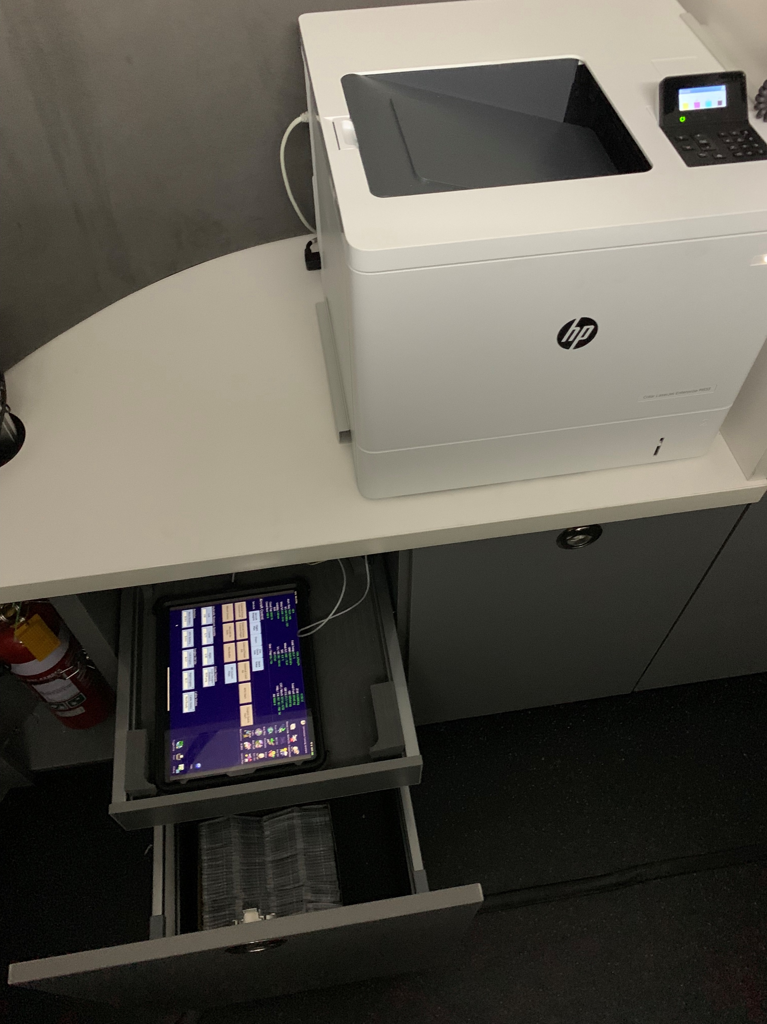
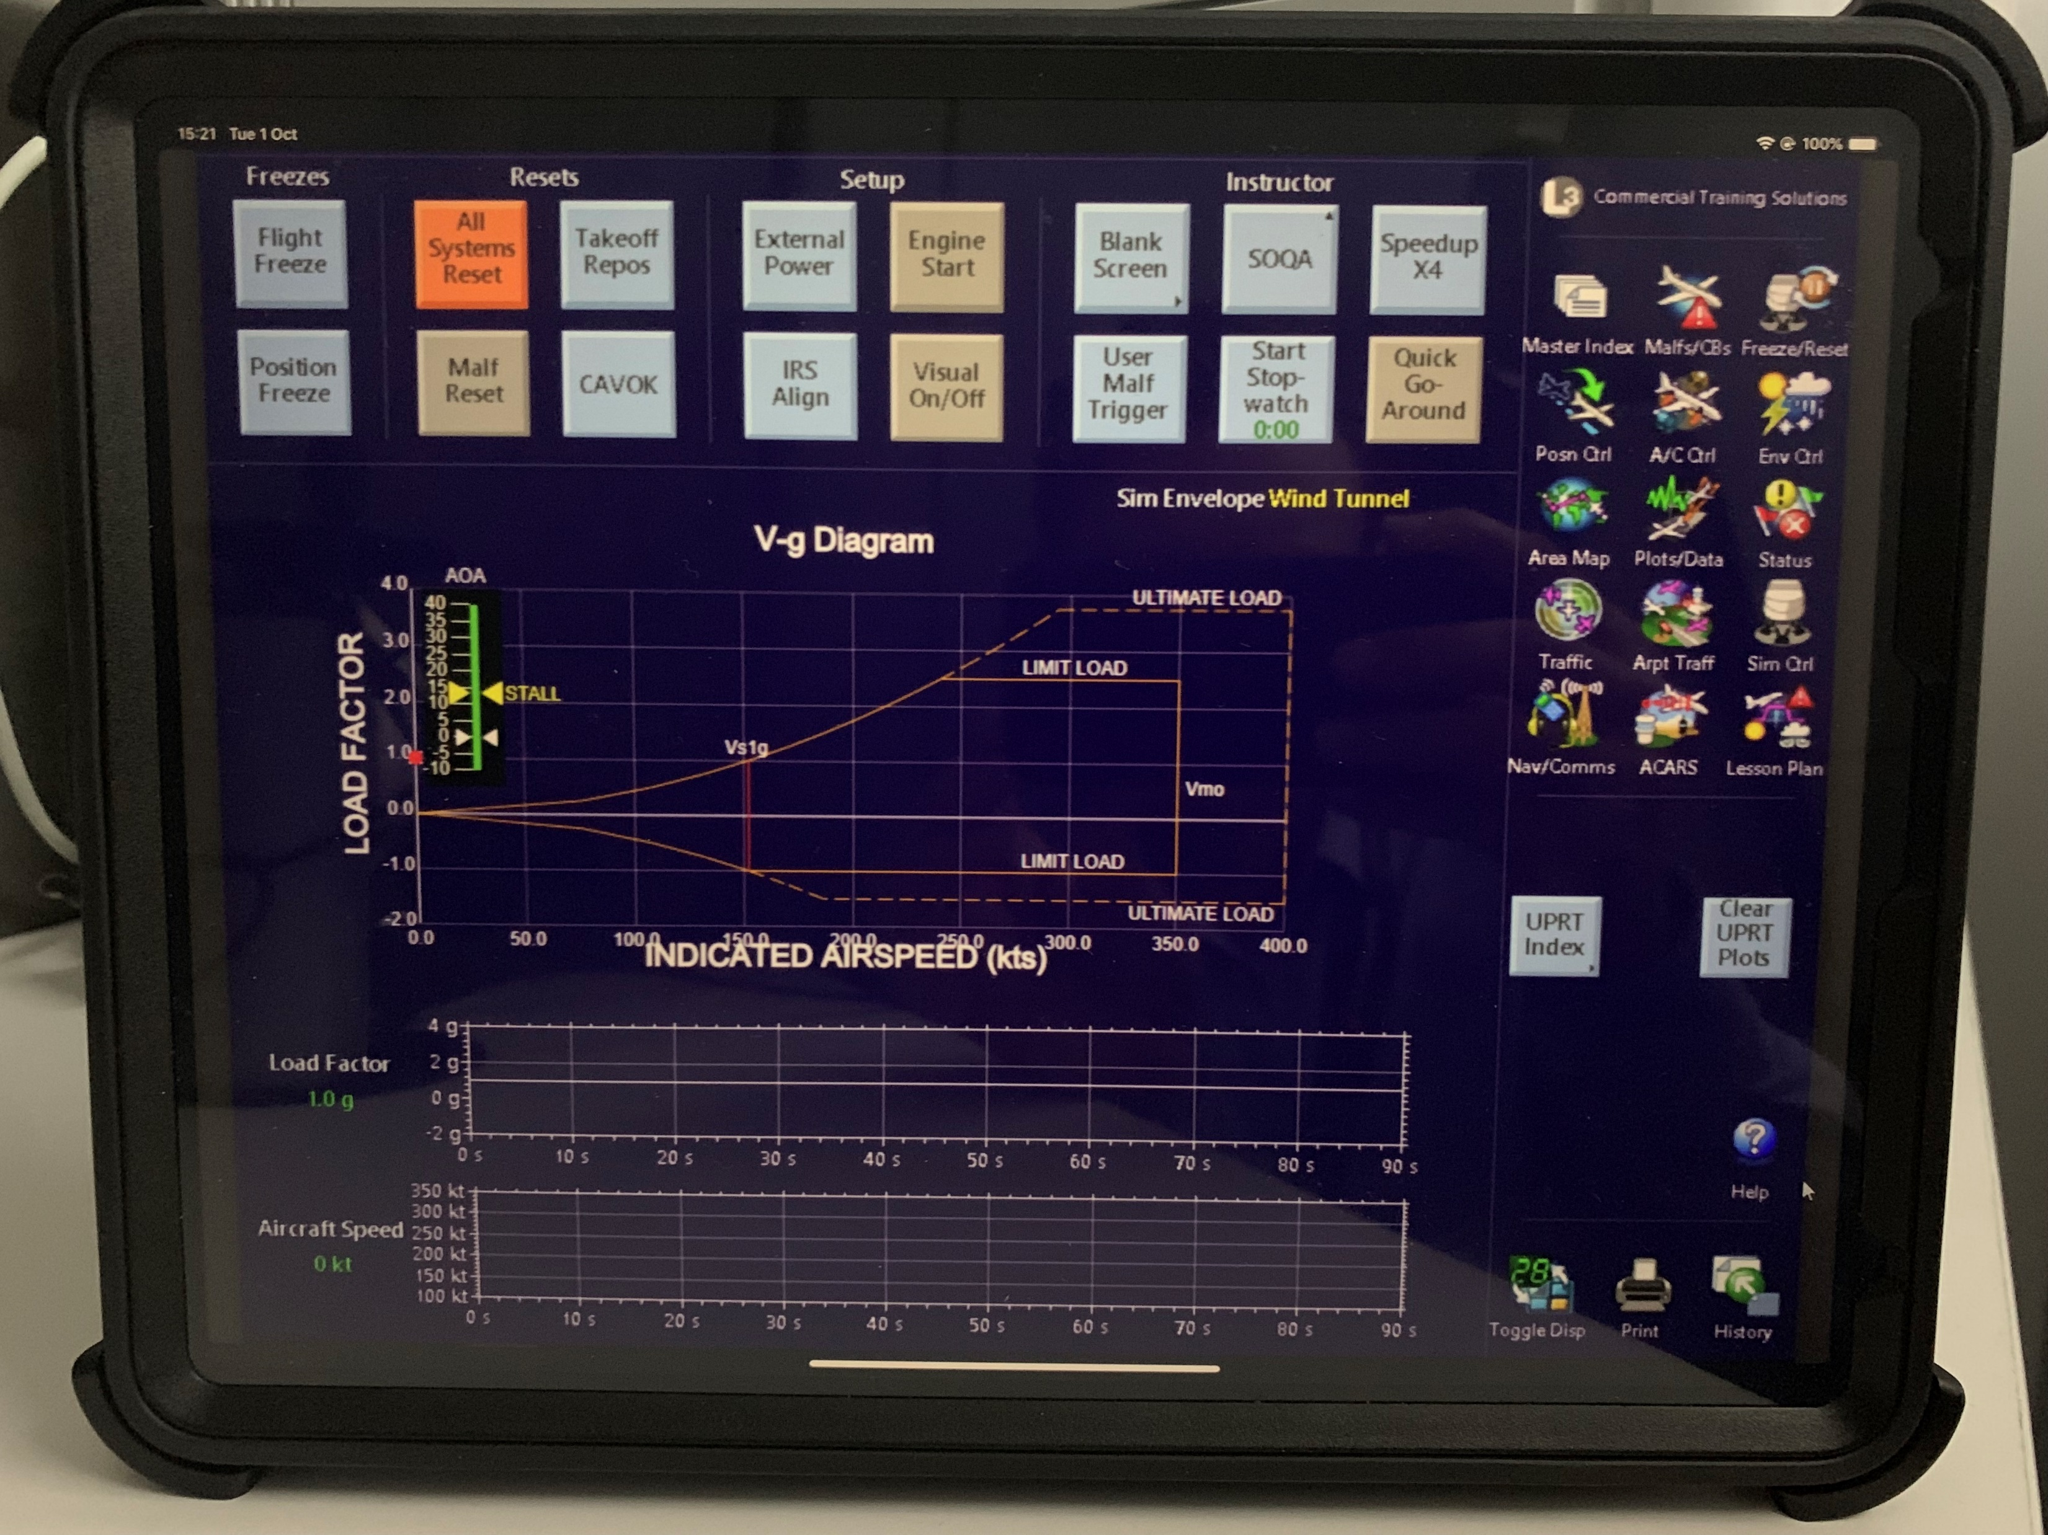
Part 1
REMOTE IOS
A remote IOS device is available – Ipad Pro
Device is stored in padded drawer with a charging cable
Device can be used to operate the simulator from a control seat – except motion
Device is also useful for showing crew plots. EG G and airspeed limits when conducting UPRT. Storage is available in sides of Instructor Seat. Do not leave on Instructor Table.
Return device to drawer, plug in power cable and turn off screen when not in use

Slide 23
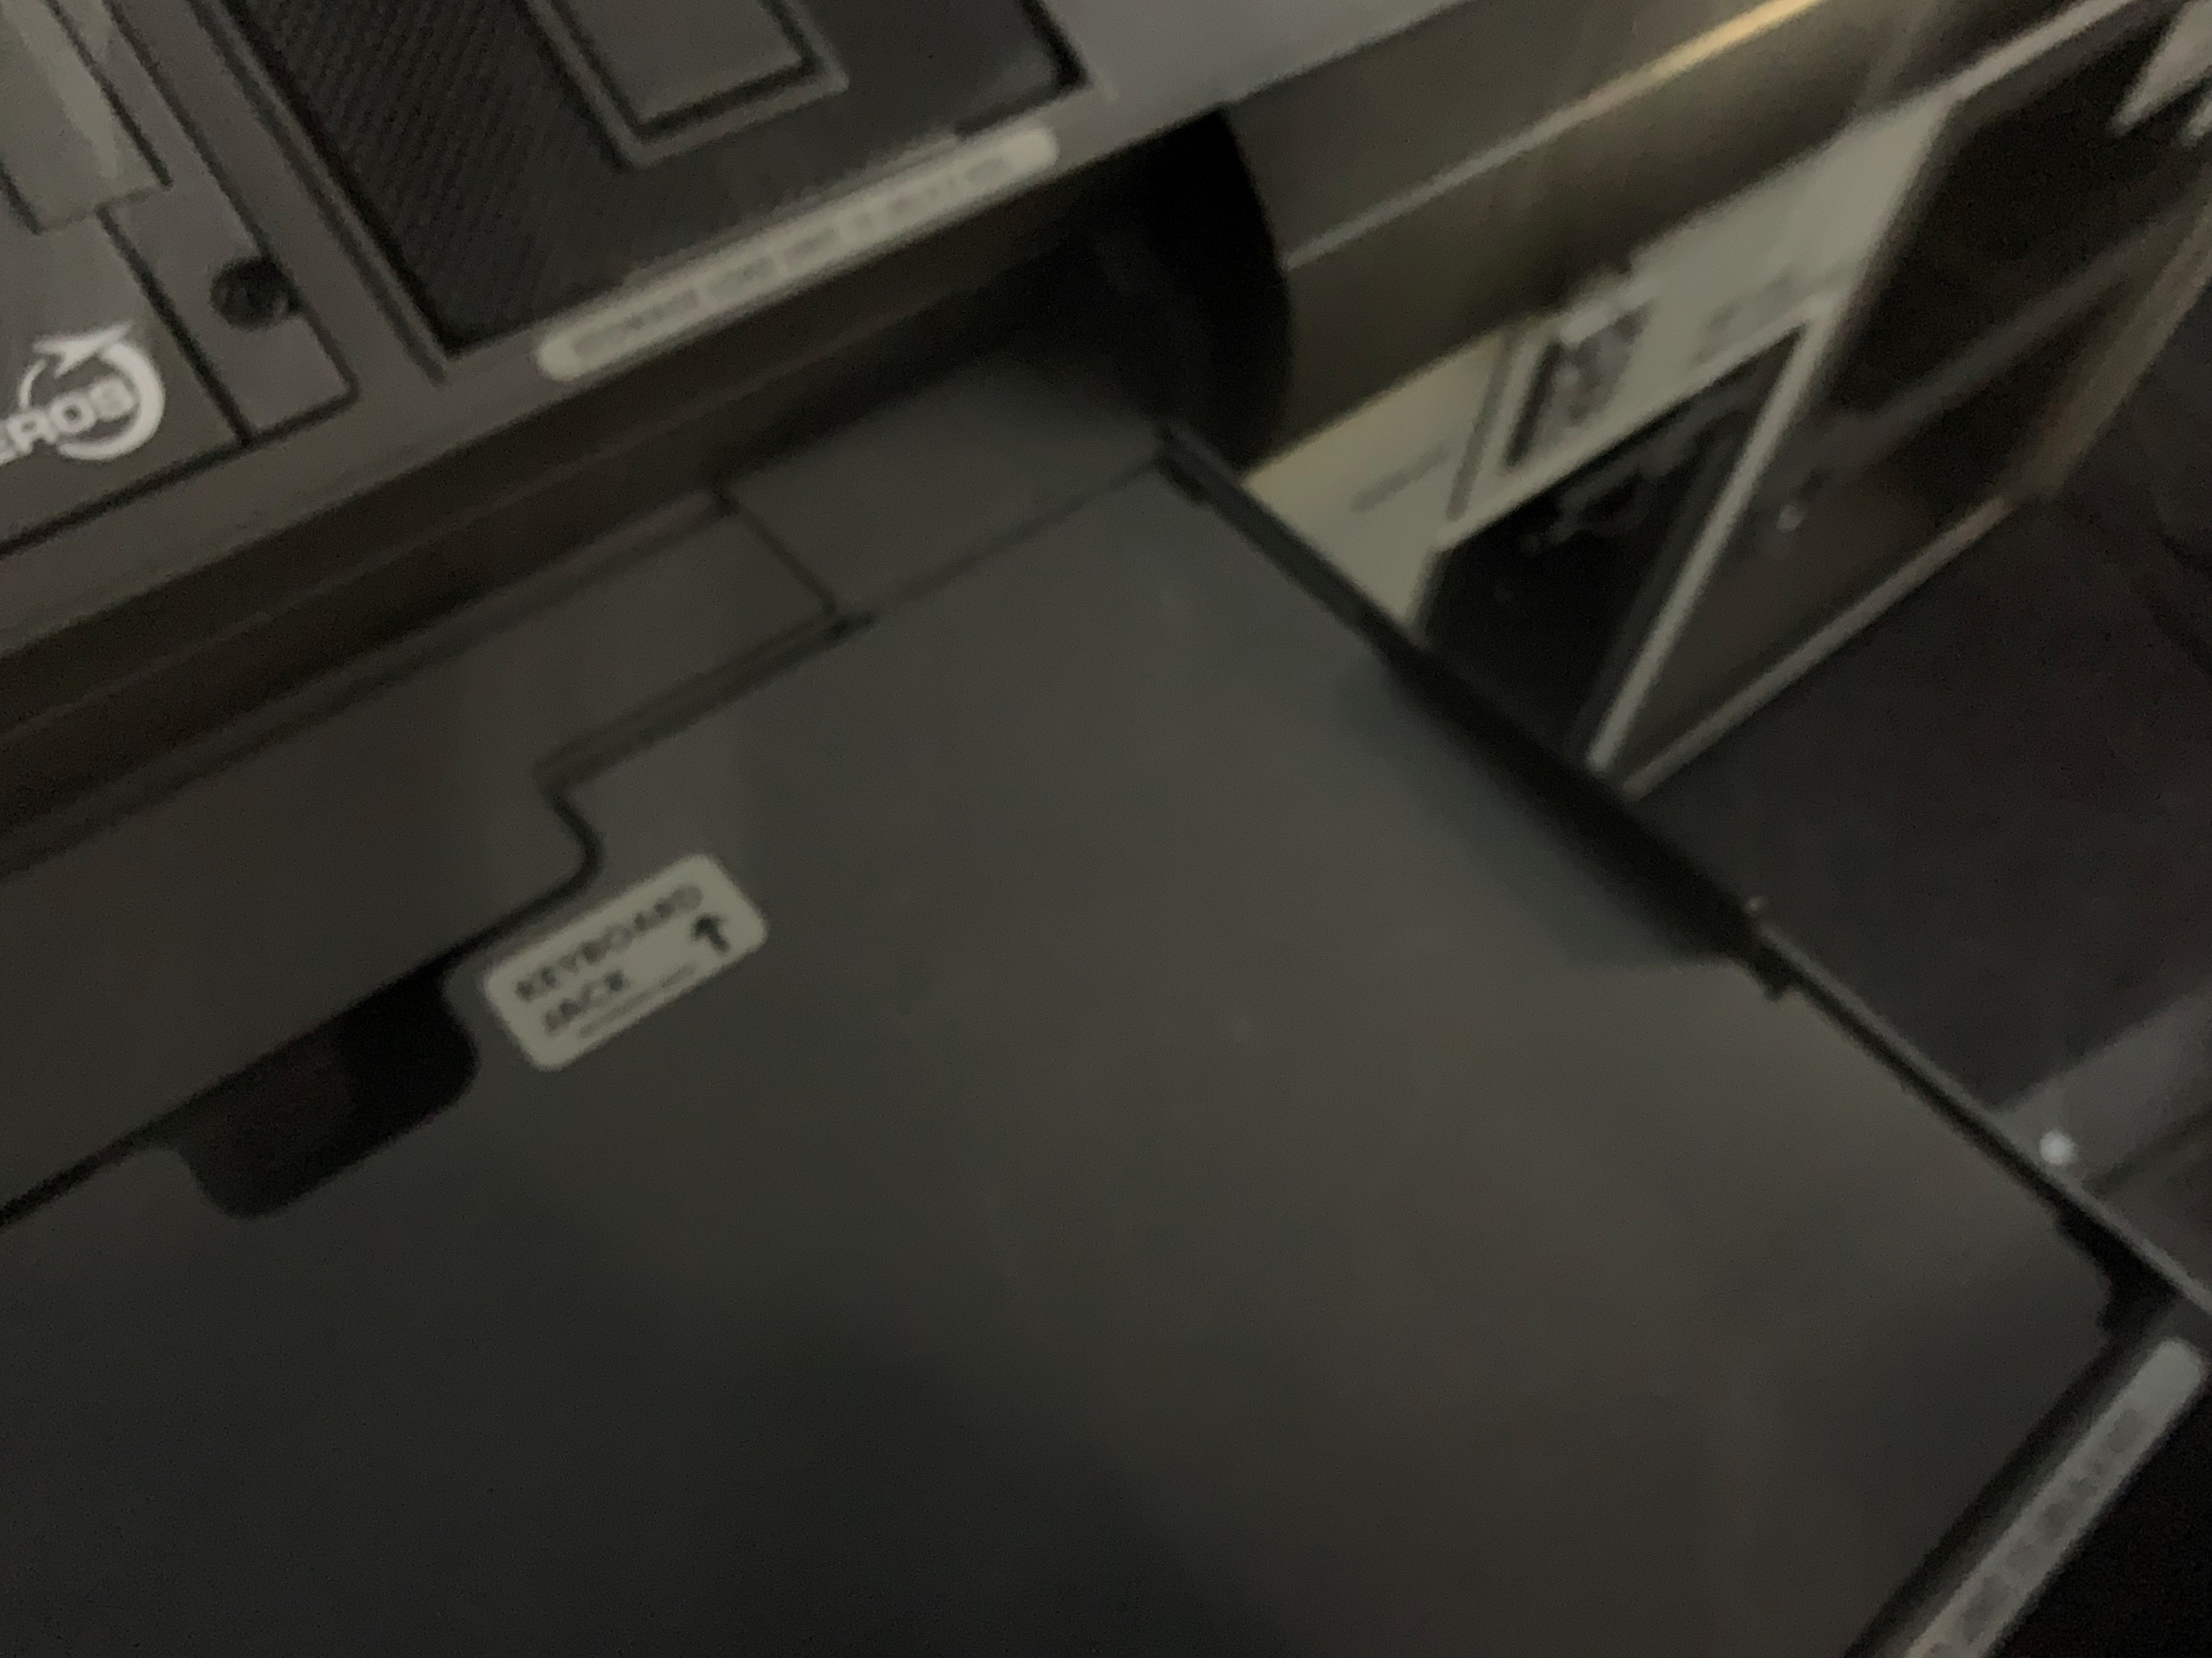
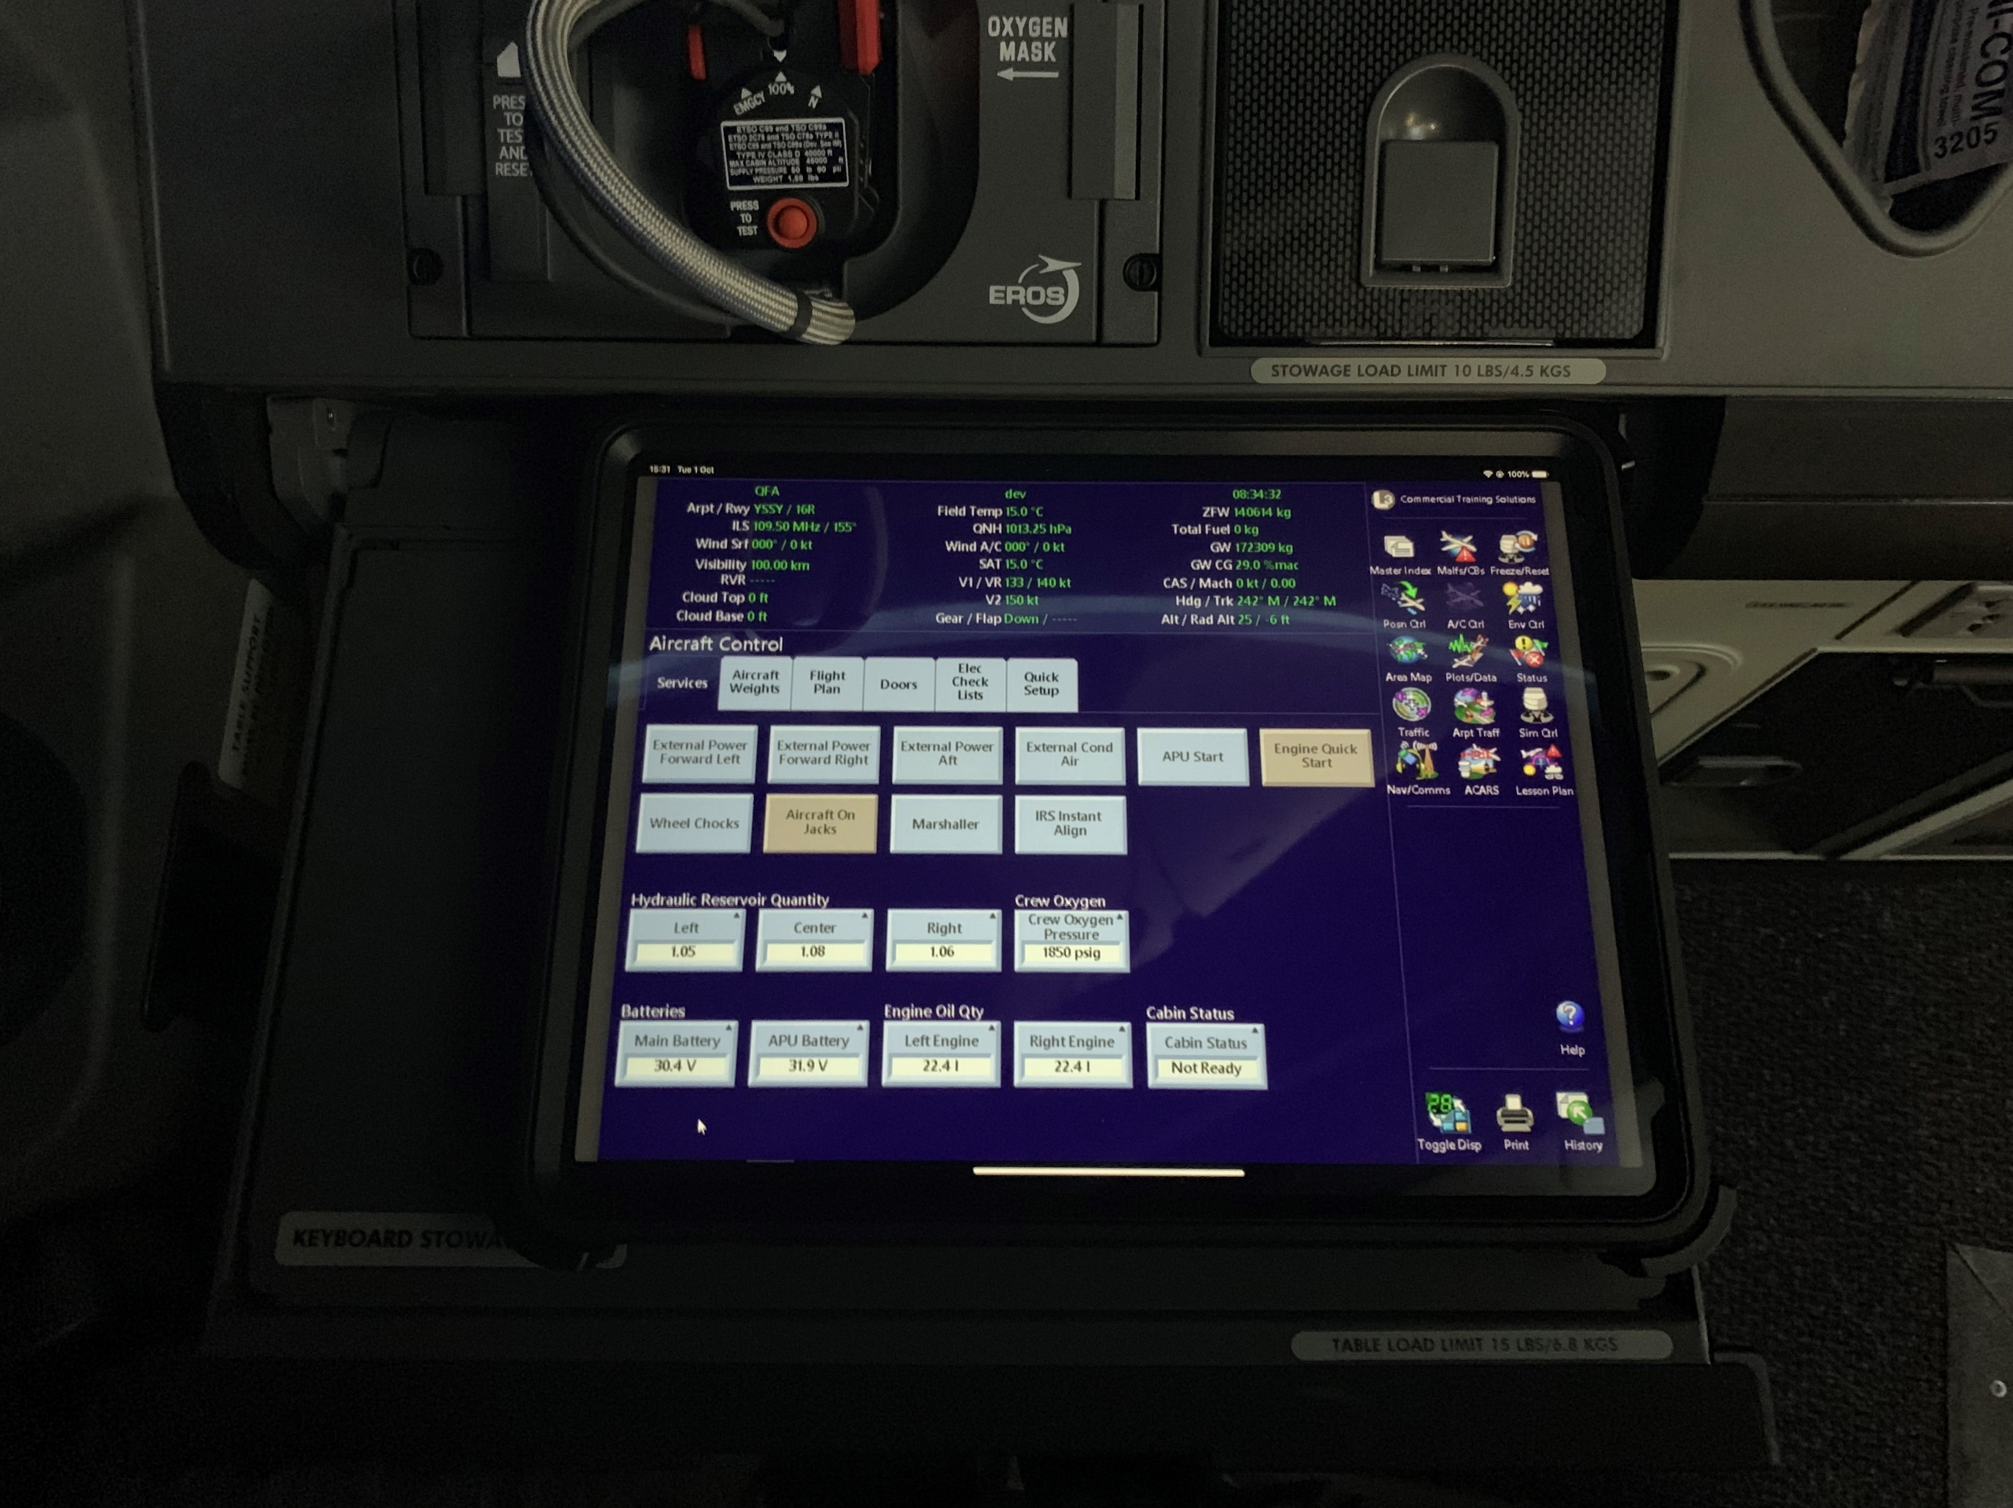
Part 1
REMOTE IOS
A pivot mount case is available so device can be used in ipad mount (not available at time of writing)
When using the device at a control seat if not utilizing the pivot mount ensure device is placed on table butted up against the side wall and the rear black retaining edge. Ensure no items (books, paper etc) are between the case non skid and the table.
Retaining edge

Slide 24
Part 1
MALFUNCTIONS
Malfunctions are accessed on the Malfunctions / Circuit Breakers Tab Suite using the Malf/CB icon
Malfunctions are grouped via ATA number
Each Malfunction can be armed or activated
Each Malfunction includes; Cause, Effect, Messages, Flight Deck Effect and Corrective / Clear Action
Take Note of the clear action as specific clear actions may be required. EG the Cargo Fire clear action shown below.

Slide 25
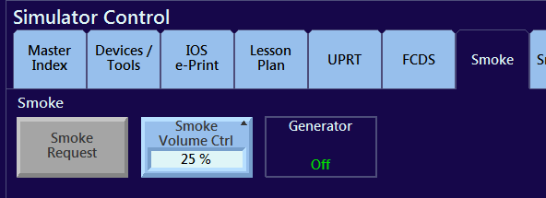
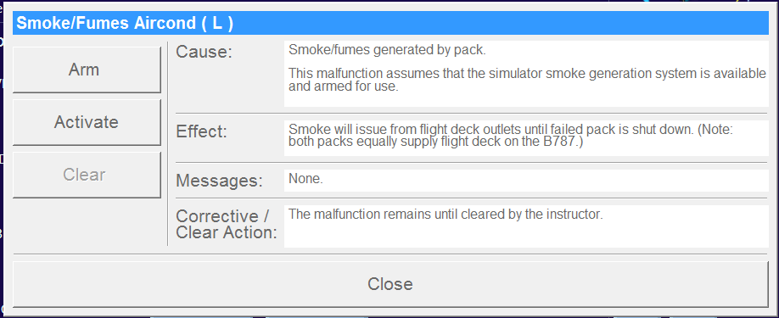
Part 1
SPECIFIC MALFUNCTION HINTS AND TRICKS
Volcanic ash
Effects are instantaneous
APU may not start
Sky will quickly turn a pink colour
Setting cloud may help with onset
A turn will not avoid the effects
Smoke
A number of Smoke Malfunctions are available on the Malfunctions page. Before activating the malfunction the smoke system must be armed. Smoke volume of 25% is sufficient for training effect. Smoke is armed on the Smoke Tab of the Simulator Control Tab Suite.

Slide 26
Part 1
SPECIFIC MALFUNCTION HINTS AND TRICKS
Engine Damage Birds RTO
The ARM speed is the speed that the scenario will start playing. IE the speed the birds start to fly towards the runway.
The Birds will hit the engine approximately 45kts after this speed. This will depend on acceleration rates.
Config Doors RTO
Open the door on the Doors Tab of the Aircraft Control rather than using the sensor malfunction
Cargo Fire RTO
Fire Warning activates approx. 20kts after activation speed

Slide 27
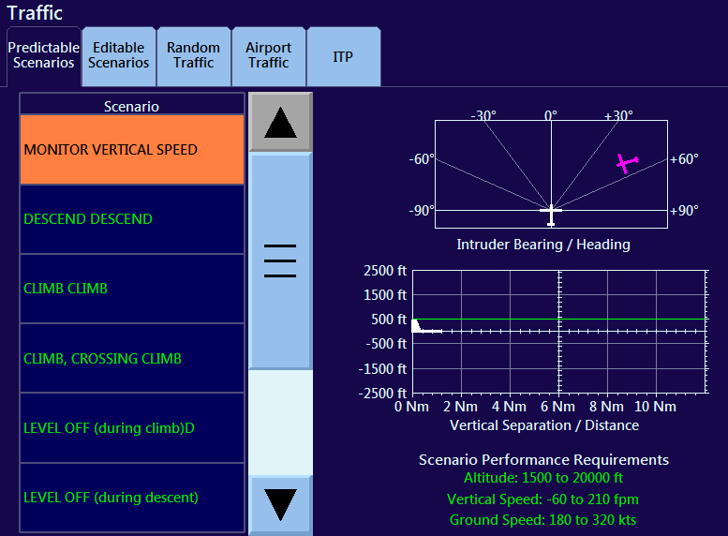
Part 1
TRAFFIC
TCAS
TCAS scenarios are available from the Predictable Scenarios Tab of the Traffic Tab Suite
Ensure Scenario Performance Requirements are met and maintained. These differ for each scenario.
Performance Requirements

Slide 28
Part 1
FIRE TRUCKS / INCURSIONS
AIRPORT TRAFFIC
Pre recorded scene traffic can be selected on the Arpt Traff page
At the time of writing Landing Traffic and a Fire Truck incursion are available. Use the page Help for more information
QUICK ACCESS RUNWAY INCURSION AND FIRE SERVICES
A quick access button for runway incursions and Emergency Services are available on the Visual / Runway Conditions Tab of the Env Cont Tab Suite
Selecting Runway Incursion will put a Vehicle or Aircraft at the holding point. Animate Incursion Vehicle will arm the vehicle/aircraft to enter the runway when going through approx. 500’.

Slide 29
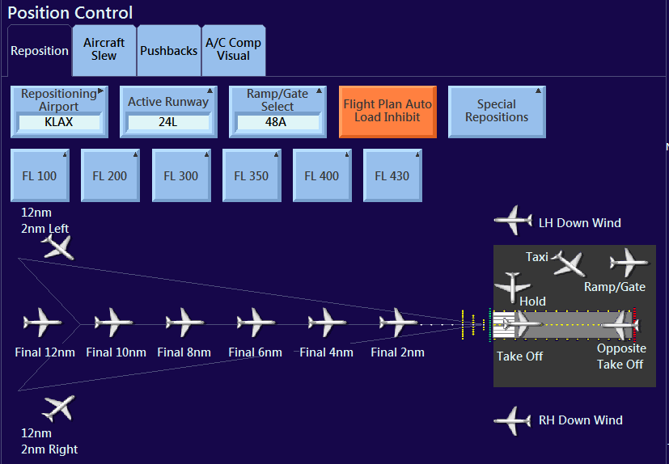
Part 1
REPOSITIONS

Slide 30
Part 1
REPOSITIONS
Reposition is finished with a chime
Do not try to engage automatics until reposition has finished
Complete all weather and weight changes before the reposition – or Airspeed Unreliable will occur, System Reset may be performed to avoid.
Fuel Freeze must be on for Take Off Speeds to be reloaded with a Take Off reposition
Flight Plan (FMC entries) can be saved and recalled on the Flight Plan Tab of Aircraft Control
Take Off Flight Plan Data is always autosaved to Flight Plan number 39
Take Off Flight Plan Data will be automatically recalled unless Flight Plan Auto Load Inhibit on the Position Control page is activated
To slew keep finger on button until slewed to desired position
Best way to slew is to put map on one display and use slew on the other
The ND map will not update until Flight Freeze removed
Map position and ANP may end up out after a slew. This will come back in slowly.

Slide 31
Part 1
AIRFIELD LIGHTING/STOP BAR/SMGS
For automatic operation of airfield lighting update Ref Runway on Posn Ctrl Page
A-SMGS (Advanced Surface movement and control system) has been setup for low visibility taxi at YMML and EGLL. Access via Environment Control - SMGS Tab
SMGS will show taxi routes to the departure runway.
Stop Bars for crossing runways will automatically operate unless “Activate Stop Bar” is used
“Proceed onto runway” is used to disable the Stop Bar onto the active runway. This will only operate if route has been programmed onto runway. To turn off the Stop bars for the departure runway if not programmed turn off SMGS then turn off the Stop Bar using the lighting control.
Stop Bars
Ensure SMGS is off
Env Ctrl Airfield Lighting Tab
Stop Bar On/Off

Slide 32
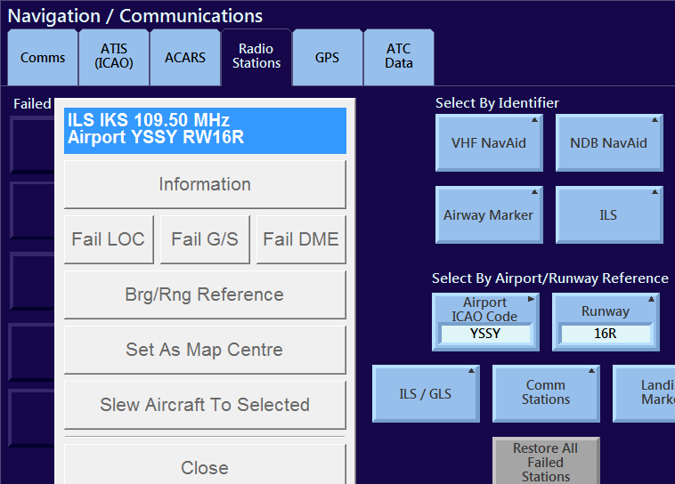
Part 1
COMMS/NAV/ACARS/CPDLC
Quick access to fail a LOC or G/S has been requested
Until implemented to Fail a LOC or G/S go to Nav/Comms
Radio Stations - ILS – Enter Ident
Functioning two way CPDLC datalink is available
Crew can request an ATIS or METAR from the COMM page and this will be auto populated with instructor entered data
Crew can request a DCL and the Instructor will receive a pop up that has pre filled and modifiable data to send a return clearance
A loadsheet can be sent from the IOS Navigation / Communications pages that is auto populated with entered data

Slide 33
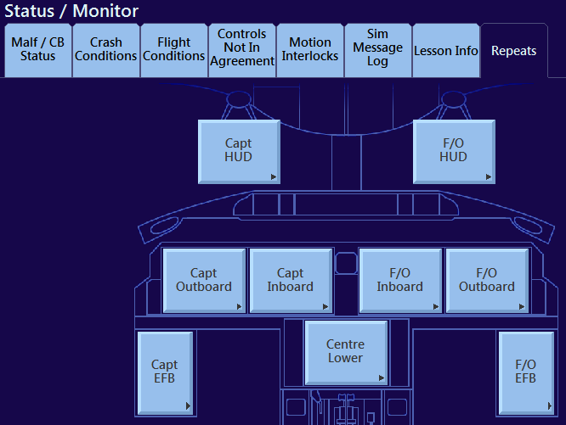
Part 1
HUD REPEATER
A third IOS screen will be installed
Until the third IOS screen is installed the HUD can be displayed by selecting the Status Tool Bar Icon then the Repeats Tab then selecting the HUD.

Slide 34
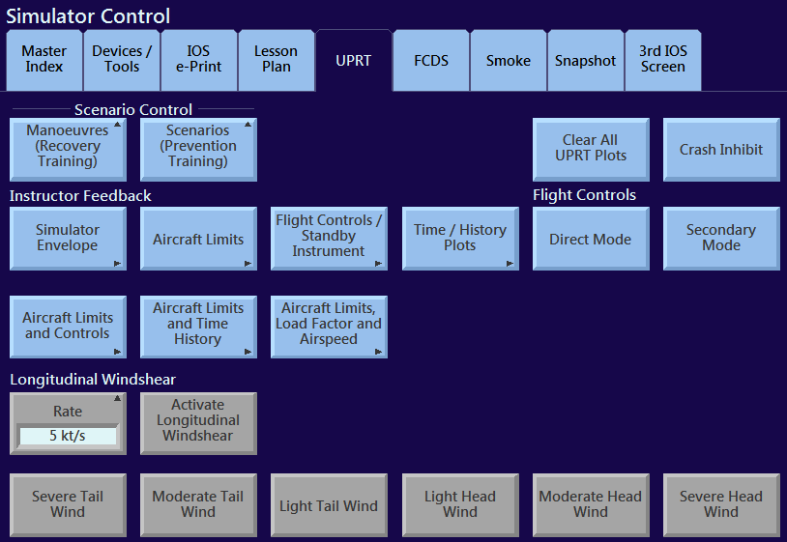
Part 1
UPRT
Two Scenario Options are available
Maneuvers – Aircraft will be put in Upset condition with Flight Freeze active
Scenarios – Aircraft will experience entered upset in flight (Similar to CAE grid UPRT function) Note: Control Input limits apply before activation of scenarios. Ensure controls are centered prior to activation
Crash Inhibit recommend to avoid crash condition from overspeed
Useful plots are available on the UPRT page – Rotate top IOS screen or utilize remote IOS device to show crew

Slide 35
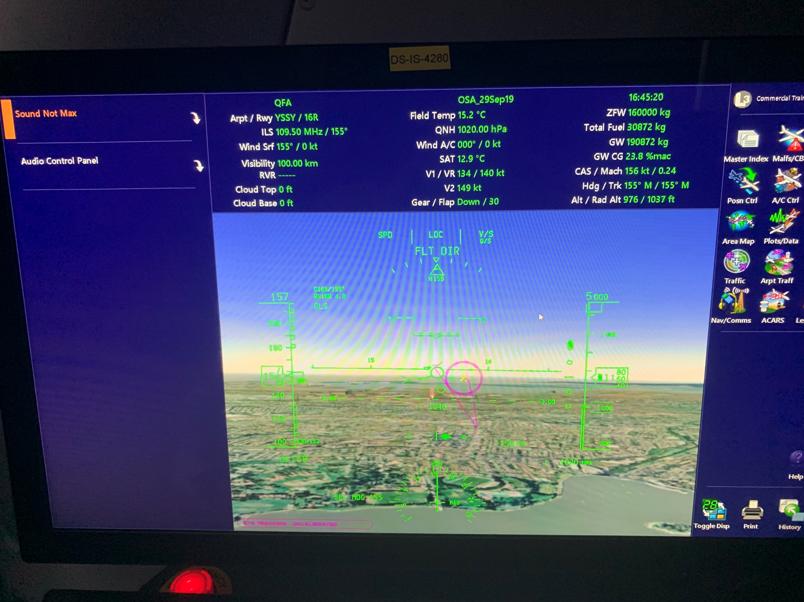
Part 1
EYE TRACKING
Eye tracking is installed
Sensor is on glareshield – Advise crew not to touch eye tracking sensor
Eye tracking shows on HUD repeats and on FCDS recording

